Slide 1

AGENT BASED MODEL OF STUDENTS IN A CLASSROOM
Daniel Kwon & Jaden Brookens
Advisor: Professor E. Araujo

Slide 2
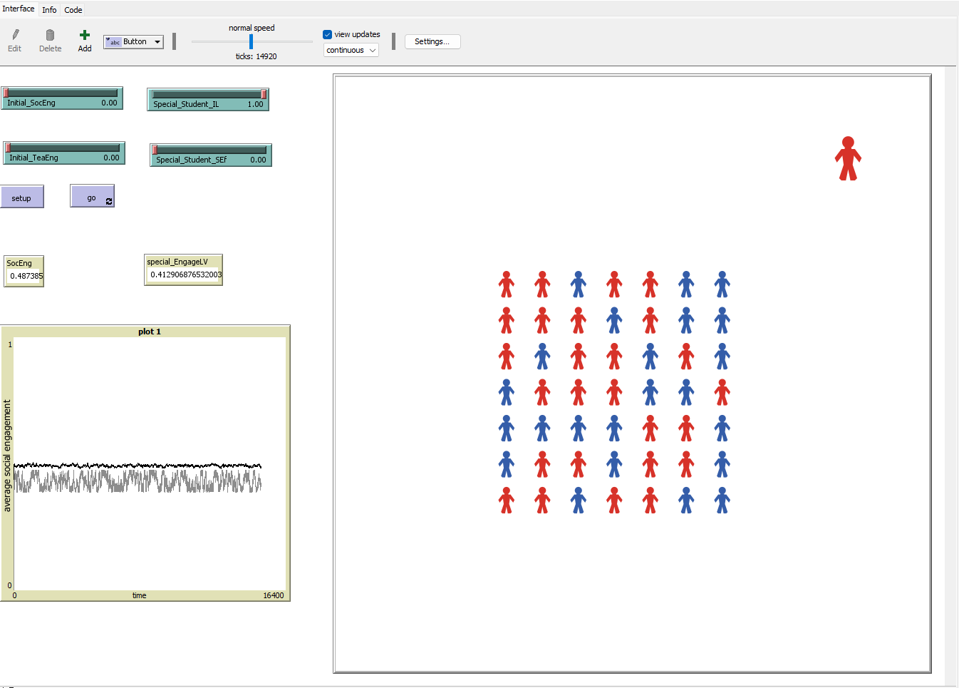

What is Agent Based Modeling
All models are wrong, some are useful.

Slide 3
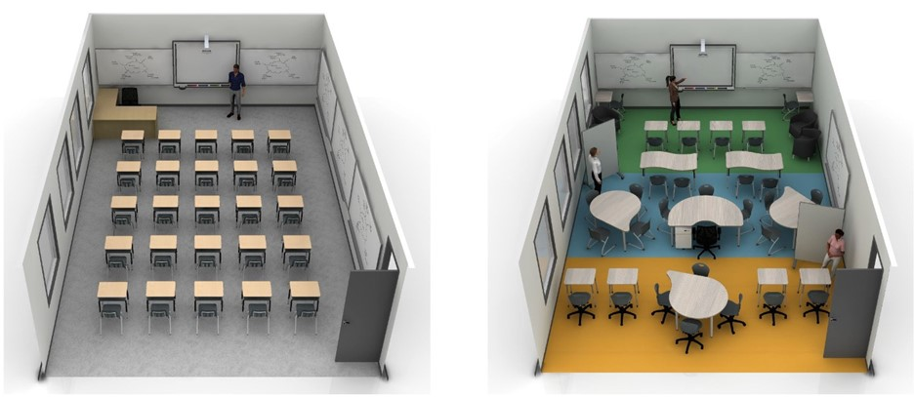
Background & Motivation
How introversion Impact on the classroom diversity and discussion dynamics?
What is the best ways for teachers to create an environment that promotes discussion?

Slide 4
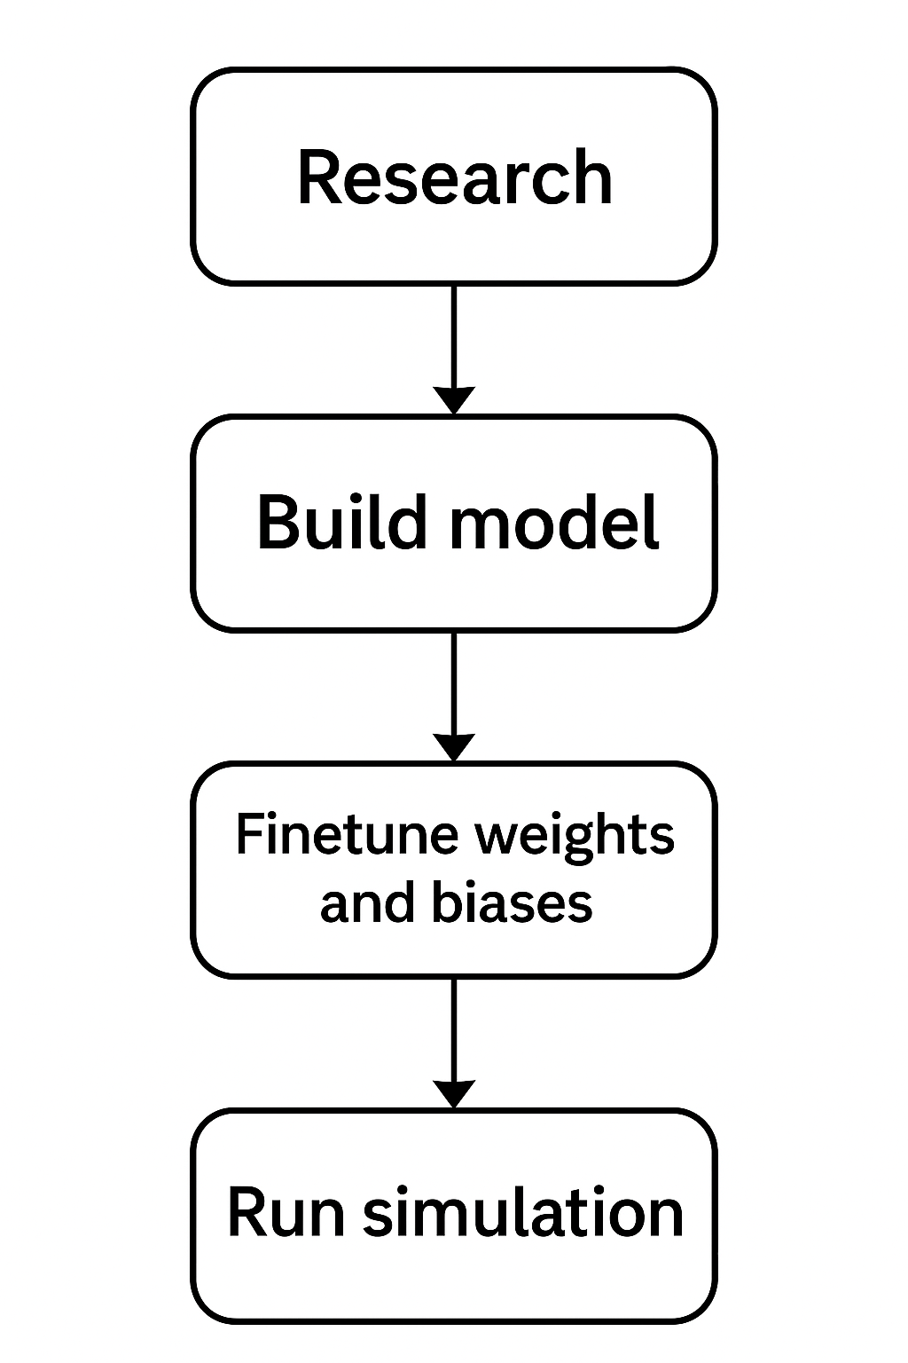
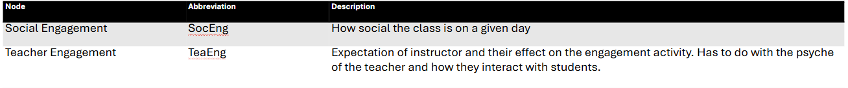
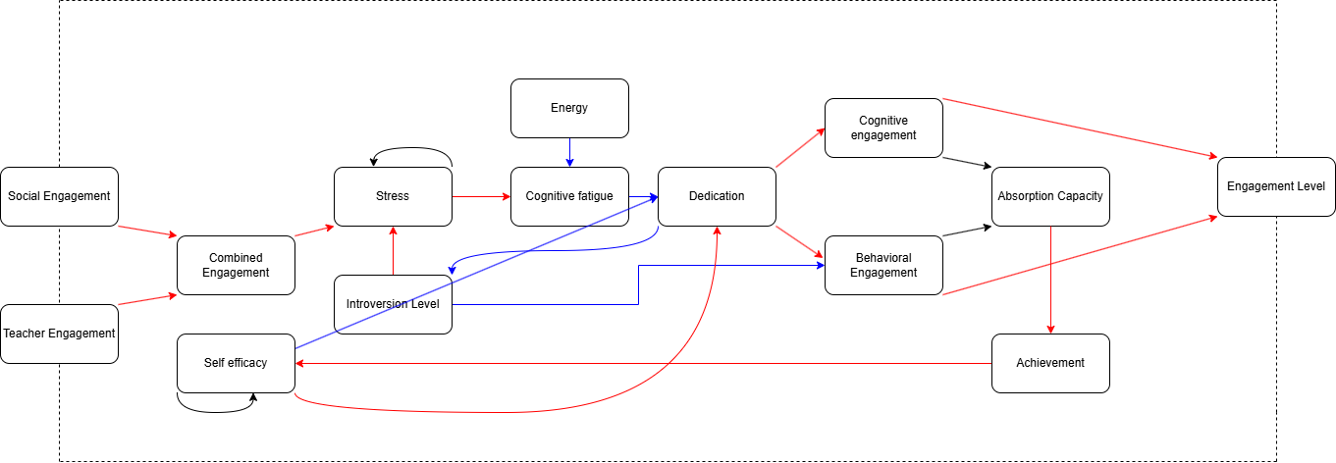
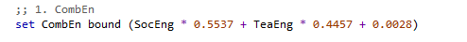
UML

Slide 5
Node | Abbreviation | Description
Social Engagement | SocEng | How social the class is on a given day
Teacher Engagement | TeaEng | Expectation of instructor and their effect on the engagement activity. Has to do with the psyche of the teacher and how they interact with students.
Introversion Level | IL | Extraversion is one of the Big Five personality traits which will be used inversely for the introversion level.
Combined Engagement | CombEn | The inner perception of the student of how his colleagues are responding to the learning technique used by the teacher.
Self-efficacy | Sef | Self-efficacy is linked to self-esteem and reflects a student’s perception of their own potential to succeed in the course
Engagement Level | EL | The probability of student is responding to class social interaction

Slide 6
Our Model
Notes:
There are two external variables in the classroom environment: social engagement and teacher engagement.
When a student perceives these variables, they form a sense of combined engagement through their cognitive processing.
This combined engagement, together with the student's level of introversion, contributes to the generation of stress—since introverted students often feel stressed in highly interactive social environments.
By considering this entire process—social engagement, teacher engagement, introversion level, and self-efficacy—we can predict the student's cognitive processing and the probability of interaction in the classroom.

Slide 7
Equation (before fine tuning):
CombEng = SocEng × w1 + TeaEng × w2
St = CombEng × w1 × IL + St × w2
Cfa = St × w1 + EL × w2
Ded = SEf × w1 + (Cfa-1) × w2
CogEng = Ded × w1
BehEng = Ded × w1 × (1-IL) + CogEng × w2
Ach = (CogEng × w1 + BehEng × w2) × AbsCap
SEf = Ach × w1 + SEf × w2
EngLev = CogEng × w1 + BehEng × w2

Slide 8
Fine tuning (gradient decent)
Create a sample dataset containing input-output pairs.
Initialize each weight in the equation to 1/n, where n is the total number of weights.
Feed inputs through the model to generate predictions.
compare with actual outputs. Optimize weights using squared error loss: (actual - predicted)²

Slide 9
DEMO

Slide 10
Equation (after fine tuning):
CombEng = (SocEng × 0.5537 + TeaEng × 0.4457) + 0.0028
St = (CombEng × 0.4815 × IL + St × 0.5431) + 0.081
Cfa = (St × 0.2000 + El × 0.5839) + 0.1199
Ded = (SEf × 0.4671 + (Cfa-1) × 0.2752) + 0.0120
CogEng = (Ded × 0.9040) + 0.7930
BehEng = (Ded × (1-IL) × 0.3308) + 0.0311
Ach = ((CogEng × 0.4270 + BehEng × 0.9885) × AbsCap) + 0.1110
SEf = (Ach × 0.6432 + SEf × 0.9605) + 0.3977
EngLev = (CogEng × 0.2662 + BehEng × 0.4566) + 0.2162

Slide 11
DEMO

Slide 12
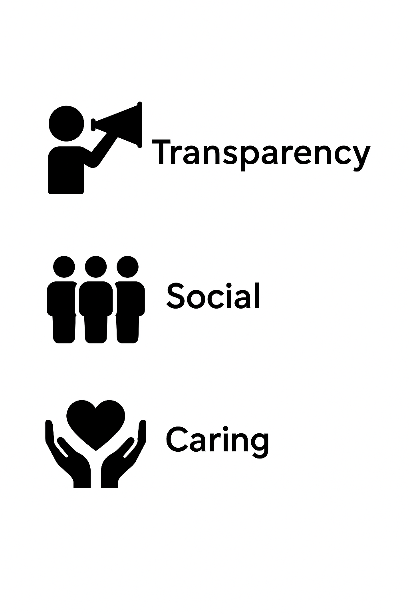
Design Norms
Transparency
ABM provides clear meanings for each layer.
Unlike neural networks, it reveals the cognitive process inside students.
Social
Designed to address barriers to classroom engagement.
Caring
Supports and empowers introverted students.

Slide 13
Outcome & Next Step
Simulation showed the importance of self-efficacy and teacher's engagement.
Introversion is important, but it is not everything.
Needs for future study (future work)​
Real data​
Research on Factors that decide teacher's engagement or self-efficacy​
Research paper & publication

Slide 14
Questions?

Slide 15
Node | Abbreviation | Description
Social Engagement | SocEng | How social the class is on a given day
Teacher Engagement | TeaEng | Expectation of instructor and their effect on the engagement activity. Has to do with the psyche of the teacher and how they interact with students.
Introversion Level | IL | Extraversion is one of the Big Five personality traits which will be used inversely for the introversion level.
Combined Engagement | CombEn | The inner perception of the student of how his colleagues are responding to the learning technique used by the teacher.
Self-efficacy | Sef | Self-efficacy is linked to self-esteem and reflects a student’s perception of their own potential to succeed in the course
Stress | St | Student’s stress level. It is linked to the introversion level and combined engagement, as factors that enhance the stress in classroom
Energy/Tired | En | The level of energy required for concentration and active engagement in the classroom.
Cognitive Fatigue | Cfa | Emotional exhaustion, leading to a reduced ability to process information presented by the teacher.
Dedication/Motivation | Ded | Student’s dedication to the course.
Cognitive Engagement | CogEng | Active cognitive engagement in the class, including listening, critical thinking, and maintaining focus.
Behavioral Engagement | BehEng | Active engagement in classroom activities, including responding to instructions, answering questions, and participating in debates
Absorption Capacity | AbsCap | The result of cognitive and behavioral engagement. It will be produced in the model by temporal-causal equations.
Achievement(Grade) | Ach | The student’s academic performance in the course, represented by their current grade.

